Slide 1


Title of the Project
VR SIDDHARTHA ENGINEERING COLLEGE, VIJAYAWADA
Department of Computer Science and Engineering
23CS7552: B. Tech Mini Project (0th/1st/2nd/End Sem. Review)
Month DD, YYYY
Batch No: __
Batch Members
Student 1 Name (Reg. No. 1)
Student 2 Name (Reg. No. 2)
Student 3 Name (Reg. No. 3)
Student 4 Name (Reg. No. 4)
Under the Guidance of
Dr./Mr./Mrs. Name of the Faculty
Designation

Slide 2
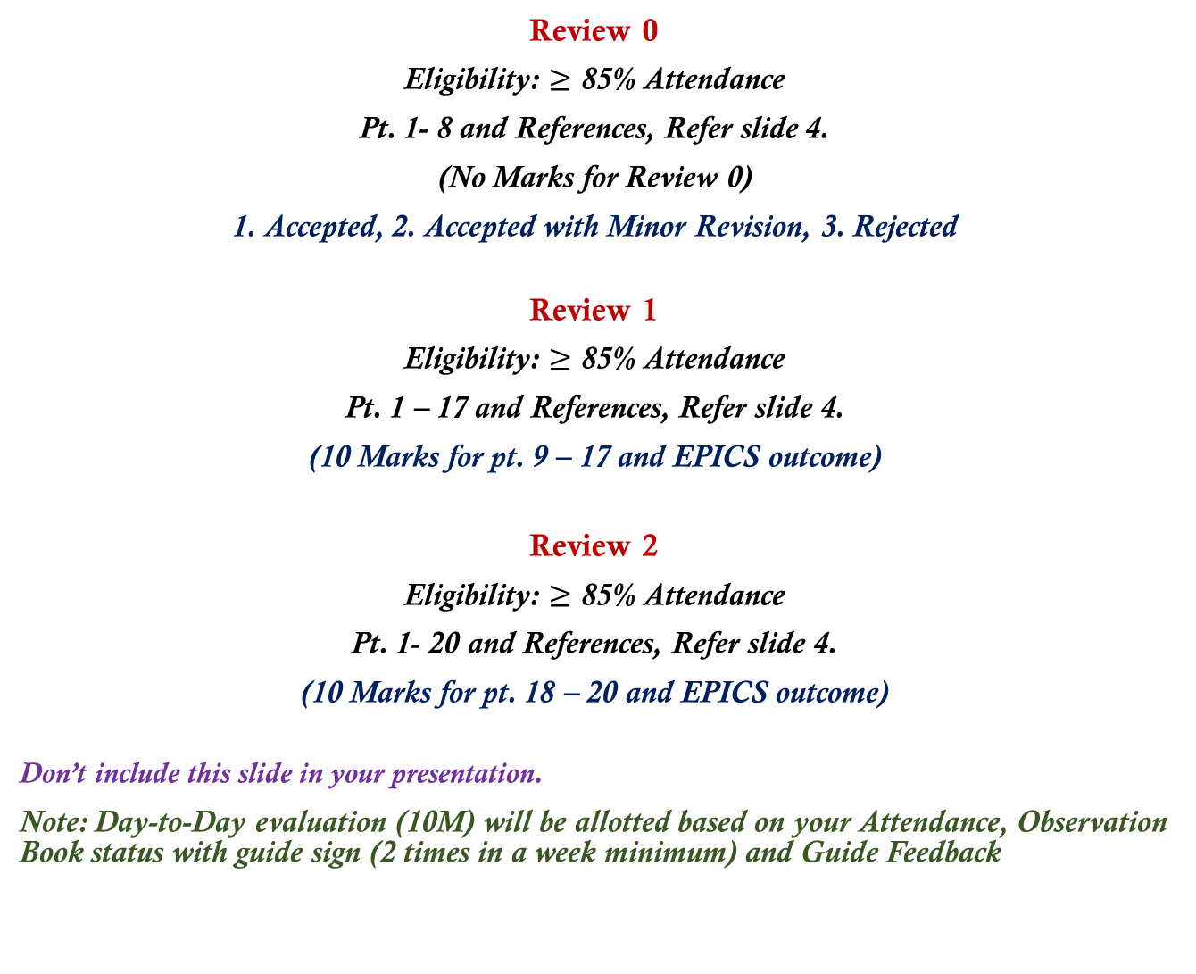
Review Details
Review 0
Eligibility: $≥$ 85% Attendance
Pt. 1- 8 and References, Refer slide 4.
(No Marks for Review 0)
1. Accepted, 2. Accepted with Minor Revision, 3. Rejected
Review 1
Eligibility: $≥$ 85% Attendance
Pt. 1 – 17 and References, Refer slide 4.
(10 Marks for pt. 9 – 17 and EPICS outcome)
Review 2
Eligibility: $≥$ 85% Attendance
Pt. 1- 20 and References, Refer slide 4.
(10 Marks for pt. 18 – 20 and EPICS outcome)
Don’t include this slide in your presentation.
Note: Day-to-Day evaluation (10M) will be allotted based on your Attendance, Observation Book status with guide sign (2 times in a week minimum) and Guide Feedback

Slide 3
Abstract
Instructions
Write the abstract between 150 and 250 words. Do not italicize your text.
It must be a paragraph that emphasizes your work/ contribution.
Highlight important words in the abstract, which will help you during your presentation.
Flow must be maintained in the abstract.
Keywords:
A minimum of five to a maximum of eight keywords separated by commas or semicolons.
Keywords are words that capture the essence of your project work.
Do not Italicize your text.

Slide 4
Presentation Outline
Research Domain
SDG Categories
Aim and Motivation
Research Questions
Title Justification
Objectives
Scope
Timeline Chart
Introduction
9.1. Basic Concepts (If any)
9.2. Basic Concepts (If any)
Study on Existing Technologies
Gap Analysis
SDLC Model (If Required, Not Mandatory for All Kinds of Projects)
UML Diagrams (If Required, Not Mandatory for All Kinds of Projects)
13.1. Use Case Diagram
13.2. Sequence Diagram
13.3. Activity Diagram
13.3. Activity Diagram
13.4. OR Any Other Diagrams
14. Functional and Non-Functional Requirements (If Required, Not Mandatory for All Kinds of Projects)
15. Data Collection (If any)
16. Data Preparation (If any)
17. Proposed Methodology
17.1. Proposed System Architecture
17.2. Different Modules
17.3 Algorithms, Model or Framework
18. Results and Discussion
18.1. Experimental Setup
18.2. Results and Analysis
18.3. Comparison with Previous Work
18.4. Proof of Concept (If Any…)
19. Project Outcomes
20. Conclusion & Future Work
References

Slide 5
1. Research Domain
Instructions
Research Domain refers to the broad area of study in which the proposed project is situated.
Select a domain that is relevant to the project title, objectives, and proposed methodology.
Clearly mention the primary research domain and, if applicable, the interdisciplinary/sub-domain.
Choose the domain based on the technical focus, application area, and expected outcomes of the project.
Example:
Primary Domain: Artificial Intelligence and Machine Learning
Sub-Domain: Computer Vision and Deep Learning
Application Area: Intelligent Transportation Systems and Road Safety

Slide 6

2. SDG Categories
Instructions
Select the SDG(s) directly aligned with the project objectives and outcomes.
Mention the SDG number and official title.
Select only relevant and justifiable SDGs based on the project’s impact.

Slide 7
3. Aim and Motivation
Instructions
Aim is a statement of intent. This is usually written in broad terms. It lays out what you hope to achieve at the end of the project.
Motivation behind a project can inspire, encourage, and stimulate individuals and project teams to achieve great accomplishments.
Highlight the major words in the aim and motivation paragraphs. It must be your own words.
You can use bullet points or a numbered list to write aim and motivation behind this project.
Do not write more than 90 words. Do not Italicize your text.

Slide 8
4. Research Questions
Instructions
A research question is a question that a research project sets out to answer. Good research questions seek to improve knowledge on an important topic and are usually narrow and specific.
A good RQ speaks about the problem statement, adds focus to the problem statement, guides data collection and analysis, and sets context of research.
These are less narrow, more focused, and more subjective in nature.
Your project must contain at least three research questions. [Try to limit your research questions to three].
Refer to https://www.scribbr.com/research-process/research-question-examples/ for framing your research questions.
Must be numbered. Neither make your texts bold nor italicize them.

Slide 9
5. Title Justification
Instructions
Justification of project title is simply validating why the proposed title is suitable for the project or what makes it a better alternative than other possible suggestions.
Highlight the major words in the title justification paragraph. It must be your own words.
You can use bullet points or a numbered list to justify your project title.
Do not write more than 90 words. Do not Italicize your text.

Slide 10
6. Objectives
Instructions
Project objectives are the noteworthy steps needed to complete a project.
Project objectives must be measurable and contain key performance indicators that will be used to assess a project's overall success.
Must be numbered. Neither make your texts bold nor italicize them.
Your project must contain at least three and a maximum of four objectives.
Objectives should not be broad but specific to your work.
Initialize each sentence with the word ‘To’.

Slide 11
7. Scope
Instructions
Scope is a way to set boundaries on your project and define exactly what goals, deadlines, and project deliverables you'll be working towards.
Clearly specify at least two scopes of your projects. The sentence should be neither too short nor too long.
Must be numbered. Neither make your texts bold nor italicize them.
It must be restricted to current project implementation.

Slide 12
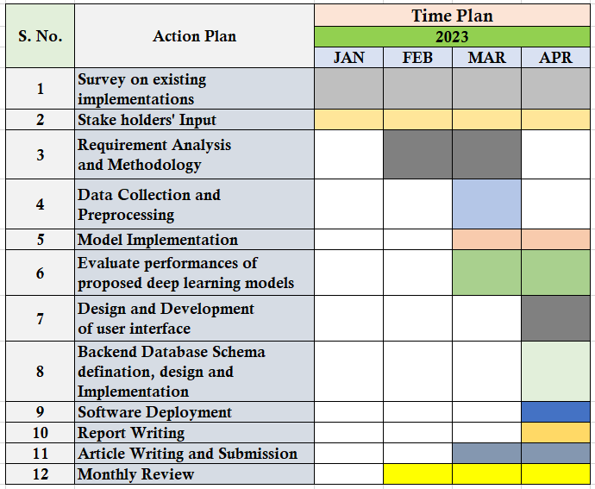
8. Timeline Chart
Table No. : Timeline chart for Mini Project work
Instruction: The content of this table can be modified based on your project work. If actions 7, 8, and 9 are part of your project, those must be reflected in your UML diagrams, functional and non-functional requirements.

Slide 13
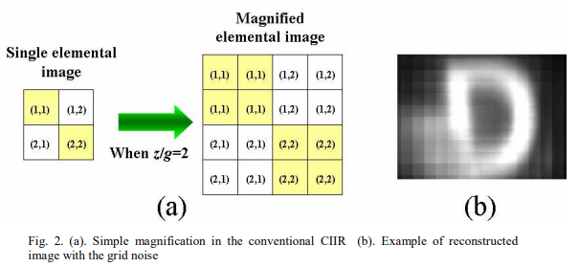
9. Introduction
Instructions
A project introduction should include key details about the project that give the reader enough information to understand the purpose and scope of the project.
Use bullet points or a numbered list to write the content. The sentences should be neither too short nor too long.
In the case of a figure, a caption must be included at the bottom. Multiple images in a single figure must be labeled as (a)..., (b)..., etc. (If required). Give citation reference to all the figures copied.
Multiple subsections of the introduction section must be labeled as 8.1., 8.2., etc.
Caption of a figure that
contains multiple images

Slide 14
10. Study on Existing Technologies
Title: Title of the article [Reference no.]
Journal Details: Name of the Journals, Vol., Issue, Publisher, Year
Dataset: ORL and Caltech Face
Description:
[Example]
Gorgel and Simsek presented Deep Stacked Denoising Sparse Autoencoders (DSDSA) for face recognition. It integrated DNN, sparse autoencoders, and smoothing techniques for robust representation of face samples with different postures, facial expressions, and occlusions under various lighting conditions. At last, the Random Forest and Multiclass Support Vector Machine (SVM) classifier trained on the facial features from the ORL and CalTech face samples had secured 97.50% and 98.21% accuracy, respectively.
Gaps Addressed:
1.
2.
Limitations:
1.
2.

Slide 15
10. Study on Existing Technologies
Instructions
You can use bullet points or a numbered list to describe the related work, or else highlight the major words in the description.
Advantages and disadvantages must be specific to your work, i.e., if your work is application-specific, these must be framed with respect to application.
If your work is algorithm- or model-specific, advantages and disadvantages must be framed with respect to algorithms and models.
Include at least eight recently published journal articles from reputed publishers. Follow the same templates [slide no. 13] for all the articles.

Slide 16
10. Study on Existing Technologies
Table no. : Summary of existing implementations
Instruction: Present a summary of all the articles (8 Minimum) in this table.
S. No. | Article Title | Journal Details | Algorithms/ Models | Dataset(s) | Gaps Addressed | Limitations
1 |  |  |  |  | 1. 2. 3. | 1. 2. 3.
2 |  |  |  |  | 1. 2. 3. | 1. 2. 3.
3 |  |  |  |  | 1. 2. 3. | 1. 2. 3.
4 |  |  |  |  | 1. 2. 3. | 1. 2. 3.

Slide 17
11. Gap Analysis
Instructions
The gap, also considered the missing piece or pieces in the research literature, is the area that has not yet been explored or is under-explored.
This could be a population or sample (size, type, location, etc.), research method, data collection and/or analysis, or other research variables or conditions.
Must be numbered. Neither make your texts bold nor italicize them.
Try to encapsulate the gap analysis within 5 to 6 points.

Slide 18
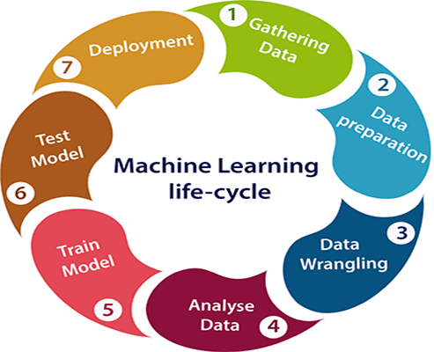
12. SDLC Model
Instructions
Select the appropriate model for your project execution. To understand different types of model https://www.tutorialspoint.com/sdlc/index.htm
It should not be generic one, all the phases must be defined with respect to your project phases.
In the case of a machine learning project, select the appropriate model (pt. 1) to represent the seven stages of the machine learning life cycle (Figure given below).
Figure number and caption must be included at the bottom with appropriate citation in the reference.
Do not describe the figure in PPT.
(No AI generated Image(s))

Slide 19
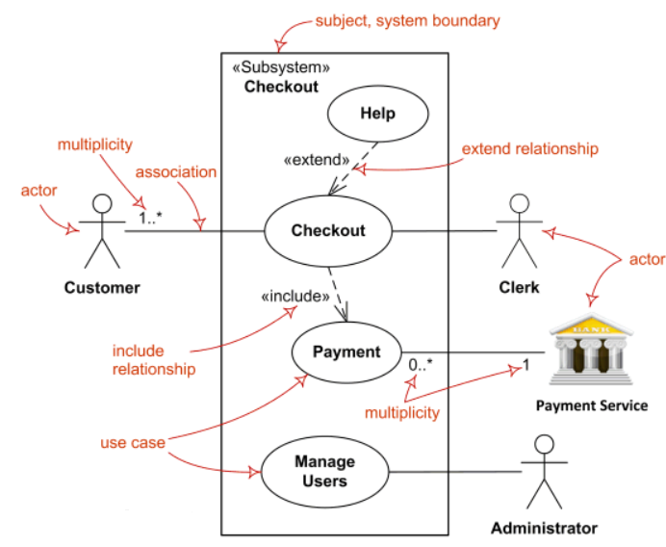
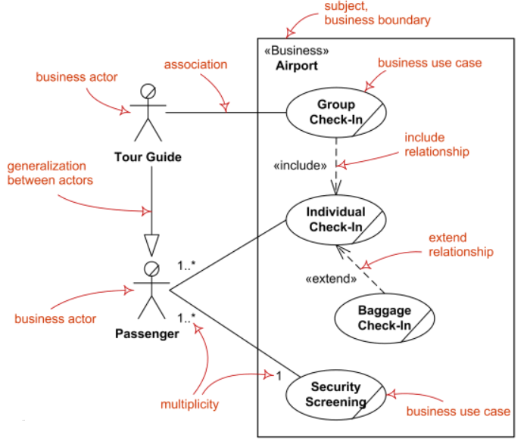
13.1. Use Case Diagram
Instructions
Select the correct actors, use cases and subject related to your project, and represent the relation between them properly. To understand activity diagram: https://www.lucidchart.com/pages/uml-use-case-diagram
Use draw.io or Lucidchart to plot your diagram. Do not include the [brown color text] in your diagram. These are only for understanding purposes. (No AI generated Image(s))
Figure number and caption must be included at the bottom. Do not describe the figure in PPT.
A few Use Case diagram examples

Slide 20
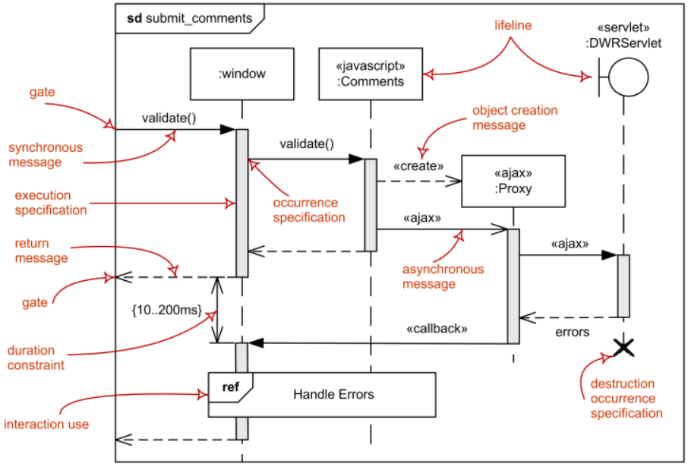
13.2. Sequence Diagram
Instructions
Use basic symbols and components in your sequence diagram as per the requirements in your project. To understand sequence diagram: https://www.lucidchart.com/pages/uml-sequence-diagram https://www.youtube.com/watch?v=pCK6prSq8aw
Use draw.io or Lucidchart to plot your diagram. Do not include [the brown color text] in your diagram. These are only for understanding purposes. (No AI generated Image(s))
Figure number and caption must be included at the bottom. Do not describe the figure in PPT.
Sequence diagram Example

Slide 21
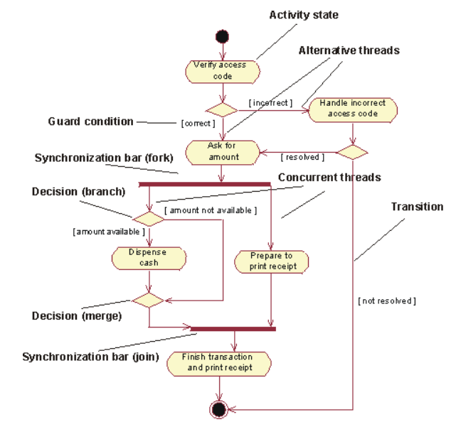
13.3. Activity Diagram
Instructions
Use activity diagram notations and symbols properly related to your project work. To understand activity diagram: https://www.lucidchart.com/pages/uml-activity-diagram https://www.youtube.com/watch?v=_tCedK0CfMk
Use draw.io or Lucidchart to plot your diagram. Do not include [the bold black color text] in your diagram. These are only for understanding purposes. (No AI generated Image(s))
Figure number and caption must be included at the bottom. Do not describe the figure in PPT.
Activity diagram Example

Slide 22
14. Functional and Non-Functional Requirements
Functional requirements: Specifically demands as basic facilities that the system should offer. All these functionalities need to be necessarily incorporated into the system.
Refer this video to frame your functional requirements: https://www.youtube.com/watch?v=D6R7njeK-qg
Non-Functional Requirements: The quality constraints that the system must satisfy according to the project.
Refer the following video to frame your non-functional requirements:
https://www.youtube.com/watch?v=2DwpAyzJrVQ
To understand functional and non-functional requirements: https://www.geeksforgeeks.org/functional-vs-non-functional-requirements/
Instructions:
Present the functional and non-functional requirements in tabular format.
The table caption must be at the top of the table. Do not Describe.

Slide 23
15. Data Collection [Example]
Name of the Dataset: UNIMIB 2016 [Reference no.]
Description: This database can be used for food recognition, segmentation as well as quantity estimation. It includes multiple food item images. This dataset was captured from The canteen situated within the ‘University of Milano-Bicocca’ campus. The particularities of this setting are that each image depicts different foods on a tray, and some foods (e.g., fruit, bread and dessert) are placed on the place mats rather than on plates. The images present visual distortions as well as illumination changes due to shadows.
Classes: 73
Number of Images : 1024
Train set size: 650 (Predefined, else specify the __%)
Test set size: 374 (Predefined, else specify the __%)
Validation set size: ___ (If any)
Image resolution: 480 x 360 pixels
Instructions:
You can use bullet points or a numbered list to describe the dataset, else highlight the major words in the description.
If you are using multiple datasets, describe those in separate slides.

Slide 24
16. Data Preparation
Instructions:
Explain the data preparation procedures, algorithms, or pseudocode (Refer slide 28) with inputs and outputs. (Vary depending on the chosen domain and your work) OR block diagram/architecture (Refer slide 27) of data preparation technique. (If required)
Display the input and output with proper captions (If required). All the figures must be centered.
In the case of a figure, a caption must be included at the bottom. Multiple images in a single figure must be labeled as (a)..., (b)..., etc. (If required)
To understand pseudo-code conventions, use this link: https://onlinelibrary.wiley.com/doi/pdf/10.1002/0470029757.app1
Caption of a figure that
contains multiple images

Slide 25
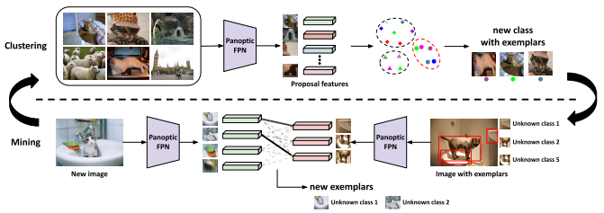
17.1. Proposed System Architecture
Instructions:
Present the overall architecture of the proposed system (No AI generated Image(s)).
Include major components, modules, inputs, processing stages, and outputs.
Clearly indicate the data flow and interconnections between components.
Mention the key technologies, algorithms, or models used.
Ensure the architecture is logical, clear, and aligned with the project objectives.
In the case of a figure, a caption must be included at the bottom. Multiple images in a single figure must be labeled as (a)..., (b)..., etc. (If required)
Proposed System example
Figure No. Write the Caption

Slide 26
17.2. Different Modules
Module 1 Name:
1.
2.
Module 2 Name:
1.
2.
Module 3 Name:
1.
2.
Module 4 Name:
1.
2.
Instructions
Describe the functionality of modules in two to three lines.
Must be numbered. Neither make your texts bold nor italicize them.

Slide 27
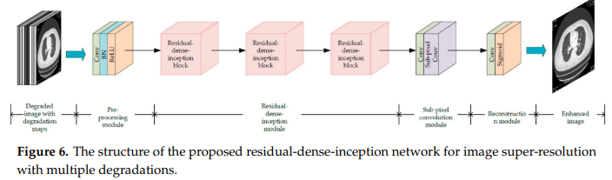
17.3. Proposed Model
Instructions
The steps of the proposed model resemble a pipeline of sequential and progressive steps, where each step builds on the input provided by a prior one and transforms it into information that is suitable for the next step of processing. (No AI generated Image(s))
It should not be too generic but specific to your work.
Figure number and caption must be included at the bottom. Do not describe the figure in PPT. Use draw.io to plot your proposed model block diagram or architecture.
In the case of deep learning models, you can use the tools for plotting different network architectures. https://github.com/ashishpatel26/Tools-to-Design-or-Visualize-Architecture-of-Neural-Network
Proposed model architecture example

Slide 28
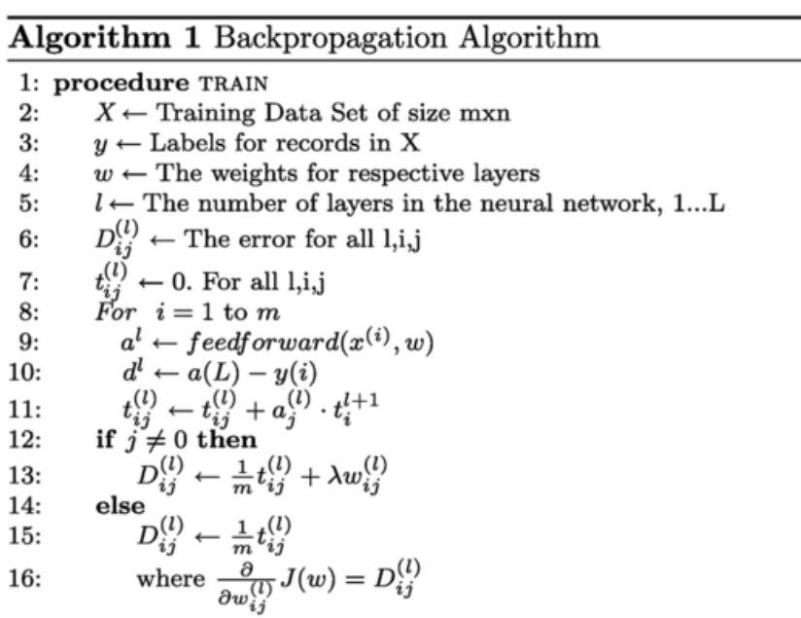
17.3. Algorithms/Pseudo Codes
Instructions
Write algorithms, or pseudocode with inputs and outputs.
Use proper mathematical notations to represent various mathematical operations.
An algorithm or pseudocode caption must be numbered and inserted at the top.
To understand pseudo-code conventions, use this link: https://onlinelibrary.wiley.com/doi/pdf/10.1002/0470029757.app1
Pseudocode example

Slide 29
18.1. Experimental Setup
Describe the experimental environment and tools/software used.
Specify the hardware and computational resources required.
Highlight the preprocessing steps, parameters, and experimental conditions.
Present the evaluation metrics and validation strategy adopted.
Include baseline models or comparative methods, where applicable.
Present the data in multiple tables with proper captions.
…
Instructions
Must be numbered, and do not italicize your text.
Multiple slides may be used to present the Information clearly.

Slide 30
18.2. Results and Analysis
Present the input and corresponding output generated by the system to demonstrate its performance and effectiveness.
Use tables for numerical or textual data, and images in case of image/ video data with proper captions.
Present the key experimental results using appropriate graphs and charts.
Include results tables for quantitative comparison of performance.
Use graphs to clearly show trends, patterns, and performance variations.
Highlight important results using accuracy, precision, recall, F1-score, RMSE, MAE, or other relevant metrics on different datasets with different partitions.
Clearly highlight the best-performing results and key findings.
…
Instructions
Images, tables and Charts must be captioned with correct Nos.
Figure captions: Bottom; Table captions: Top.

Slide 31
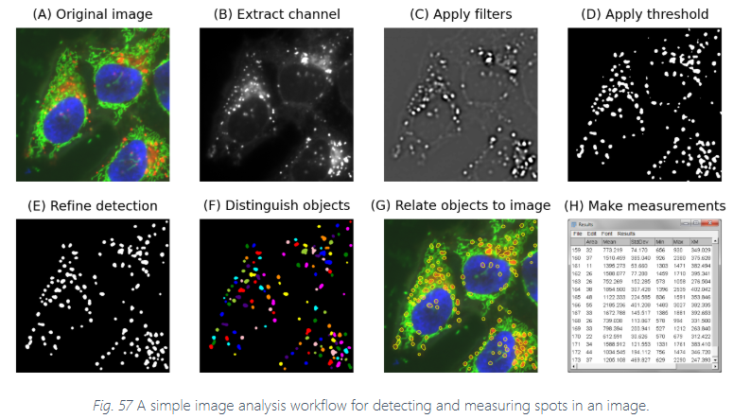
18.2. Results and Analysis
(Samples)

Slide 32
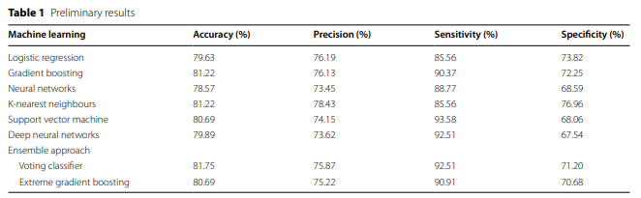
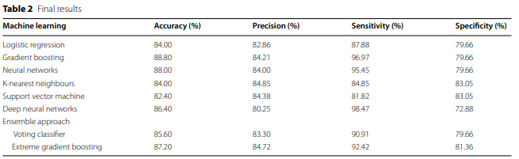
18.2. Results and Analysis
(Samples)

Slide 33
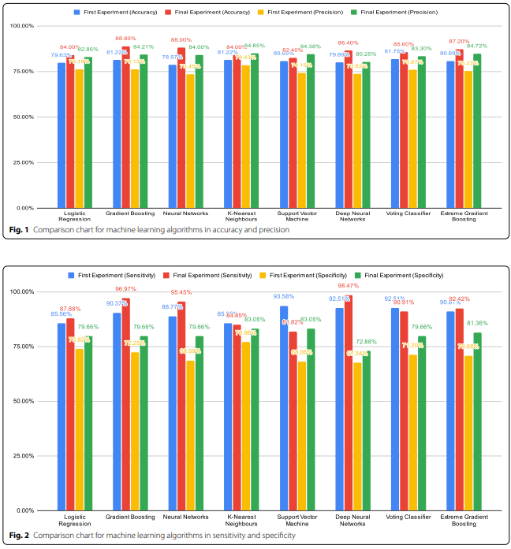
18.2. Results and Analysis
(Samples)

Slide 34
18.3. Comparison with Previous Work
Table No. : Comparison with Previous Implementation
S. No. | Literature | Algorithms/ Models | Dataset(s) | Performance Metrics
1 | Wang et al. (2022) [8] | Algorithm/ Model Name - Purpose Algorithm/ Model Name – Purpose … | Dataset 1 Name Dataset 2 Name … | Dataset 1 Accuracy: ?? Precision: ?? IoU: ?? … Dataset 2 …
2 | … | … | … | ..
3 | … | … | … | …
4 | … | … | … | …
5 | … | … | … | …
6 | … | … | … | …
7 | … | … | … | …
8 | … | … | … | …
9 | Our Work | Algorithm/ Model Name - Purpose Algorithm/ Model Name – Purpose … | Dataset 1 Name Dataset 2 Name … | Dataset 1 Accuracy: ?? Precision: ?? IoU: ?? … Dataset 2 …

Slide 35
18.4. Proof of Concept [If Any …]
Show prototype screenshots, system interface, or working demonstration.
Must be captioned, annotated, and labelled thoroughly with nos.
Present sample inputs, outputs, and key performance results.
Provide 2–3 practical use cases demonstrating real-world applicability.
Mention the current implementation status and scope for further enhancement.
…
Instructions
Must be numbered, and do not italicize your text.
All the points must be covered in multiple slides.

Slide 36
19. Project Outcomes
EPICS
Title: ??
Types: Journal/Book Chapter/ Conference/ Patent
Name of Journal/Book Chapter/ Conference: ??
Status: Submitted/ Accepted/ Published (in case of Journal/Book Chapter/ Conference)
Filed/ Published/ Granted (In case of Patent)
DOI: (In case of published Journal/Book Chapter/ Conference)
Ref. No.: (In case of Patent)
Mini Project
Title: ??
Types: Journal/Book Chapter/ Conference/ Patent
Name of Journal/Book Chapter/ Conference: ??
Status: Submitted/ Accepted/ Published (in case of Journal/Book Chapter/ Conference)
Filed/ Published/ Granted (In case of Patent)
DOI: (In case of published Journal/Book Chapter/ Conference)
Ref. No.: (In case of Patent)

Slide 37
20. Conclusion & Future Work
Here, we have discussed
1. The real-world problem that motivate us to carry out this project.
2.
3.
4.
…
Instructions
Must be numbered, and do not italicize your text.
Try to encapsulate the conclusion of your presentation within 6 to 7 points.
Try to encapsulate the Future work within 1 to 2 points

Slide 38
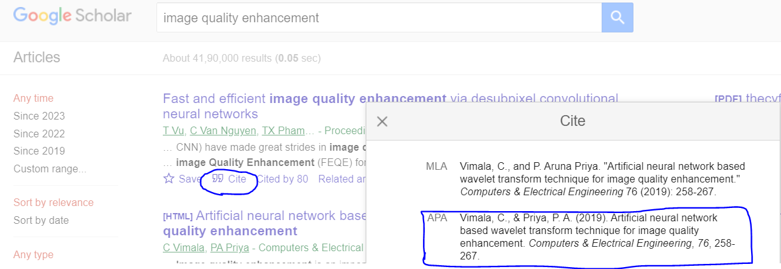
References
Vimala, C., & Priya, P. A. (2019). Artificial neural network-based wavelet transform technique for image quality enhancement. Computers & Electrical Engineering, 76, 258-267.
…
Instructions
The same order must be maintained throughout the PPT.
In the case of online materials, unpublished work, or online videos, use the following URL to generate APA references.
https://www.scribbr.com/citation/generator/apa/

Slide 39
Insert Slide Numbers
Slide numbers are important.
It not only helps reviewers any questions but also helps you answer them.
[Don’t include this slide to your PPT]

